Slide 1
Autonomous Discovery for BCR Signaling and Cell Fate Decisions
Bayard Walsh

Slide 2
Data Pipeline
Select best experimental plan per hypothesis
Translate high-level experimental plans into detailed, step-by-step protocol
Correlate synthetic data and rank most correlated hypotheses
Group papers and generate hypotheses
Generate several varied experimental plans per hypotheses
Generate and parse synthetic data for each hypothesis

Slide 3
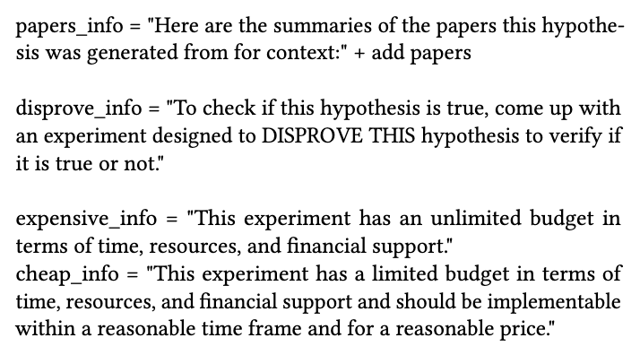
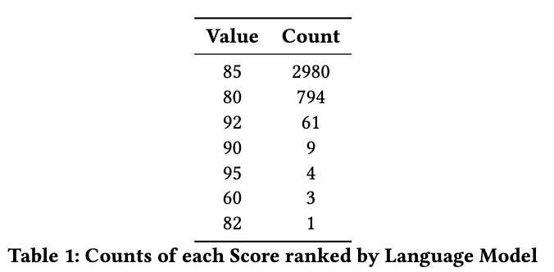
Tree of Thought Prompting
Generate 12 Experimental plans per hypothesis
Vary context, disprove hypothesis, or budget for experimental plans
Drawbacks
Deterministic Model
No-context window with network
Extensive runtime (22 hours for 329 hypothesis)
Evaluating outcome with model had homogenous results on varied input, difficult to determine “best” experimental plan

Slide 4
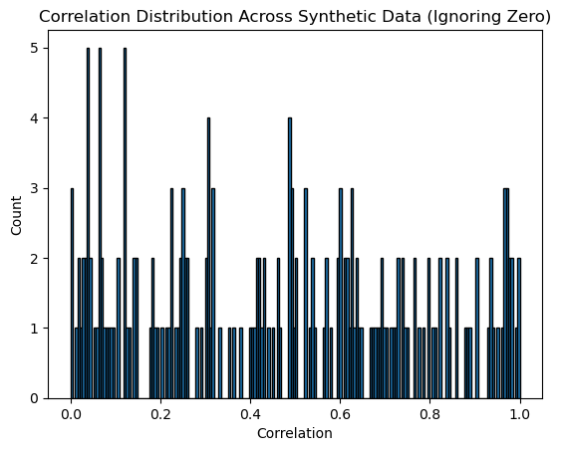
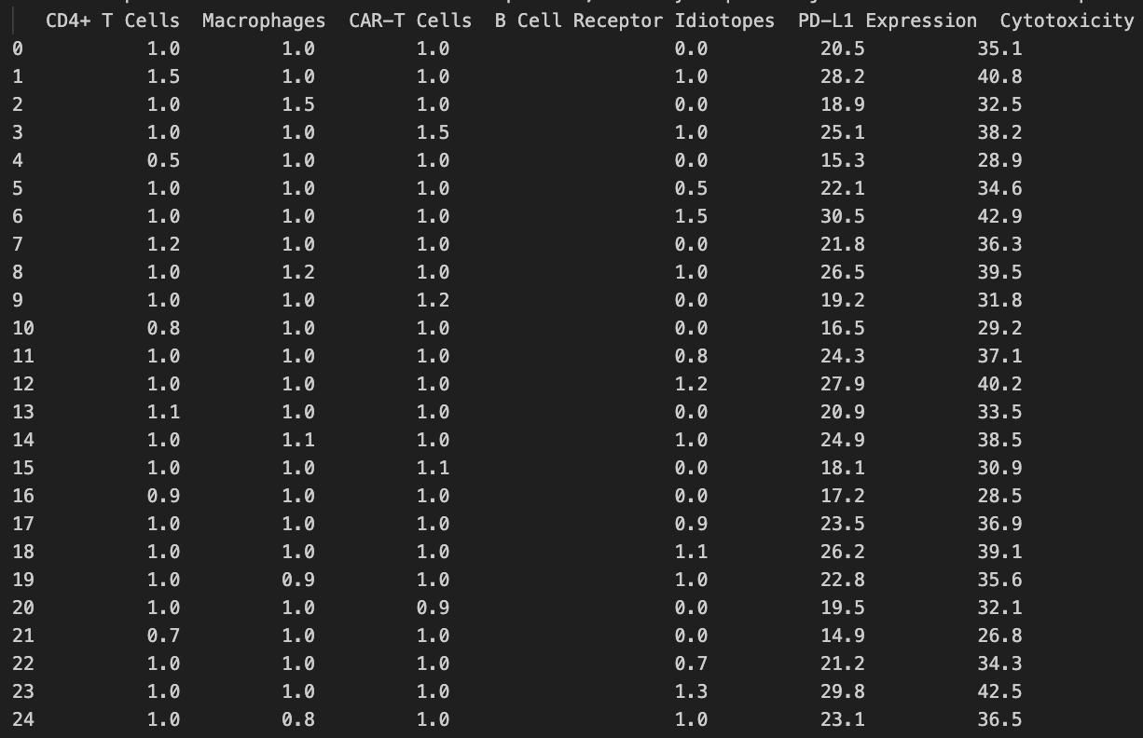
Synthetic Data
Generate CSV of synthetic data for each experiment
Use linear correlation of variables with expected outcome to determine correlation factor
Benefits
Provides real number meaning greater granularity and easier to rank values
Drawbacks
Difficult to parse some CSVs
General framework is hard to incorporate non numerical variables
Unclear how data is generated, where estimates come from (previously seen papers/ dataframes)

Slide 5
Highest Ranked Hypotheses
Correlation : 1.0 Does the integration of BAFF, TLR, and RGC-32 signals in atypical B cells promote the production of VH4-34 autoantibodies, contributing to the development of autoimmune responses in SLE patients?
Correlation : 0.997 Can the controlled covalent attachment of a targeting ligand to gold nanoparticles also enhance the delivery of immunotherapeutic agents to cancer cells, leading to increased anti-tumor immune responses?
Correlation : 0.990 Do CXCL13+CD4+ T cells in skin TLSs of pemphigus patients also regulate Treg function through a feedback loop, thereby modulating the chronic blister microenvironment?
Correlation : 0.984 Can the co _ expression of tTRII_I7R and TYK2 in CAR _T cells enhance their anti_ tumor efficacy and prevent tumor recurrence in B cell lymphoma by converting immunosuppressive TGF_b signaling into immune activating IL_ 7 signaling and restoring IFNa_mediated immune surveillance?
Correlation : 0.981 Does the cell-specific expression of transposable elements in immune cells influence the development of autoreactive B cell subsets in systemic lupus erythematosus, leading to the production of pathogenic autoantibodies?

Slide 6
Thanks for Listening!

